Slide 1

Lab 02 gpio AND led
Prof. Davide Brunelli
Dept. of Industrial Engineering – DII
University of Trento, Italy
davide.brunelli@unitn.it

Slide 2
Stm32 cubemx

Slide 3
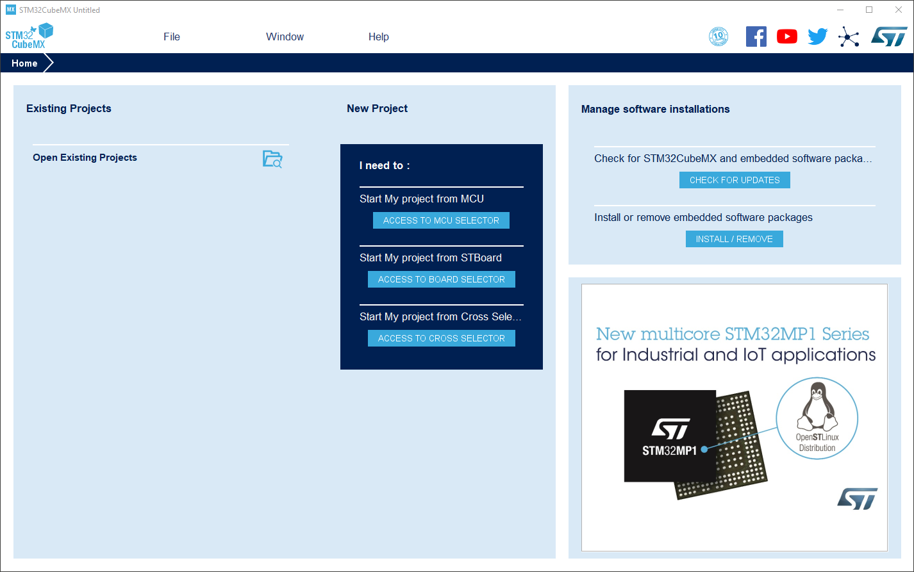
Stm32 cubemx – selecting the board
A graphical tool which enables fast configuration of STM32 microcontrollers and microprocessors.
Generates the corresponding C code for the Arm Coretex core.

Slide 4
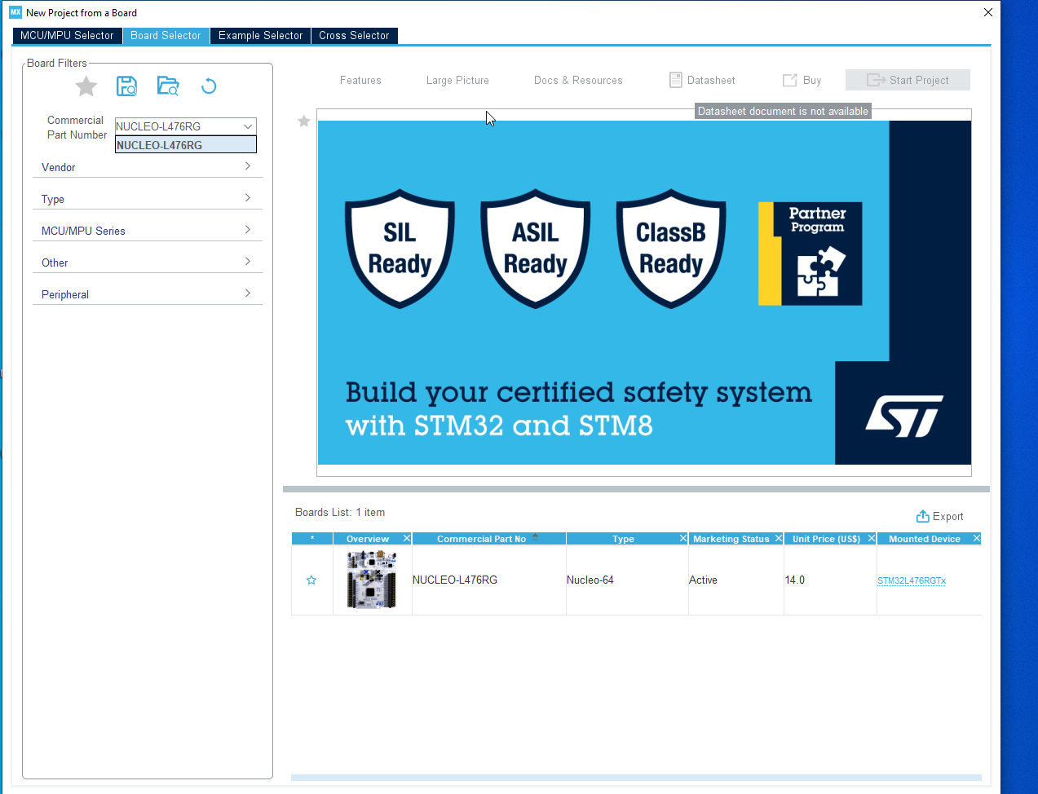
Stm32 cubemx – selecting the board

Slide 5
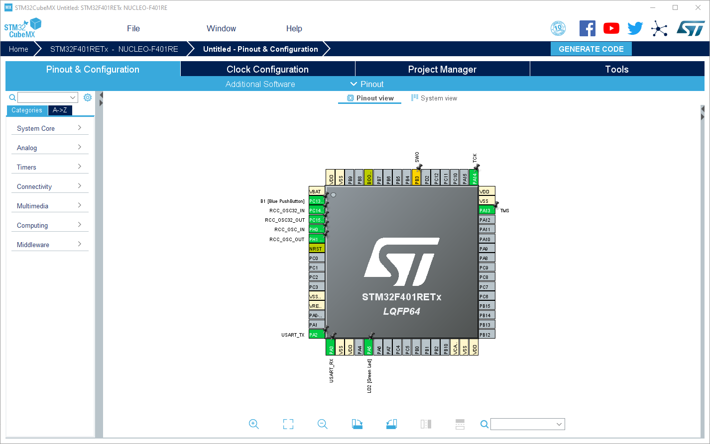
Stm32 cubemx – multiplexing the pins
Selected pins are preassigned, since we are using a development board, with predefined connections

Slide 6
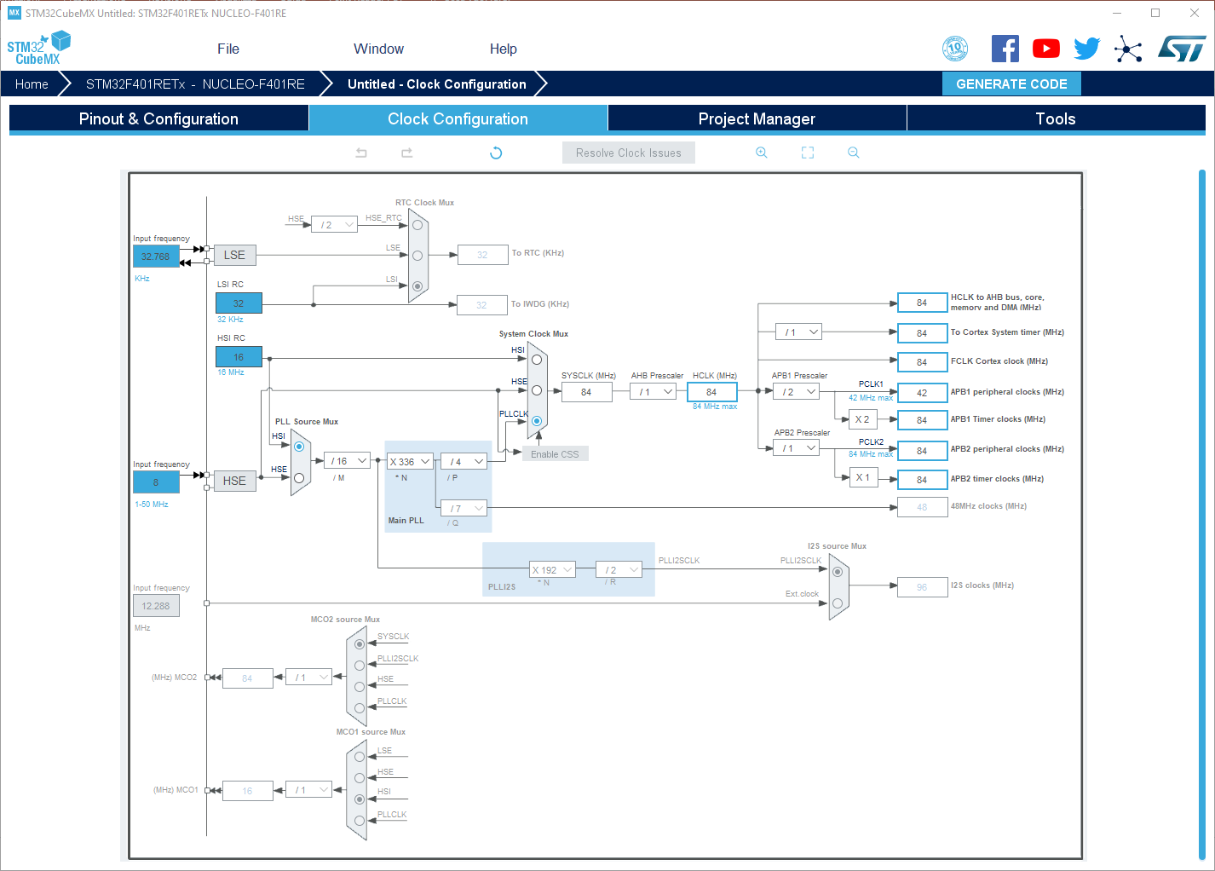
Stm32 cubemx – setting the clocks
PERIPHERAL CLOCK
CLOCK
SOURCE
CPU FREQ
Clock tab allows us to configure the clock. Here you can select your clock source, the CPU frequency and the peripheral clock

Slide 7
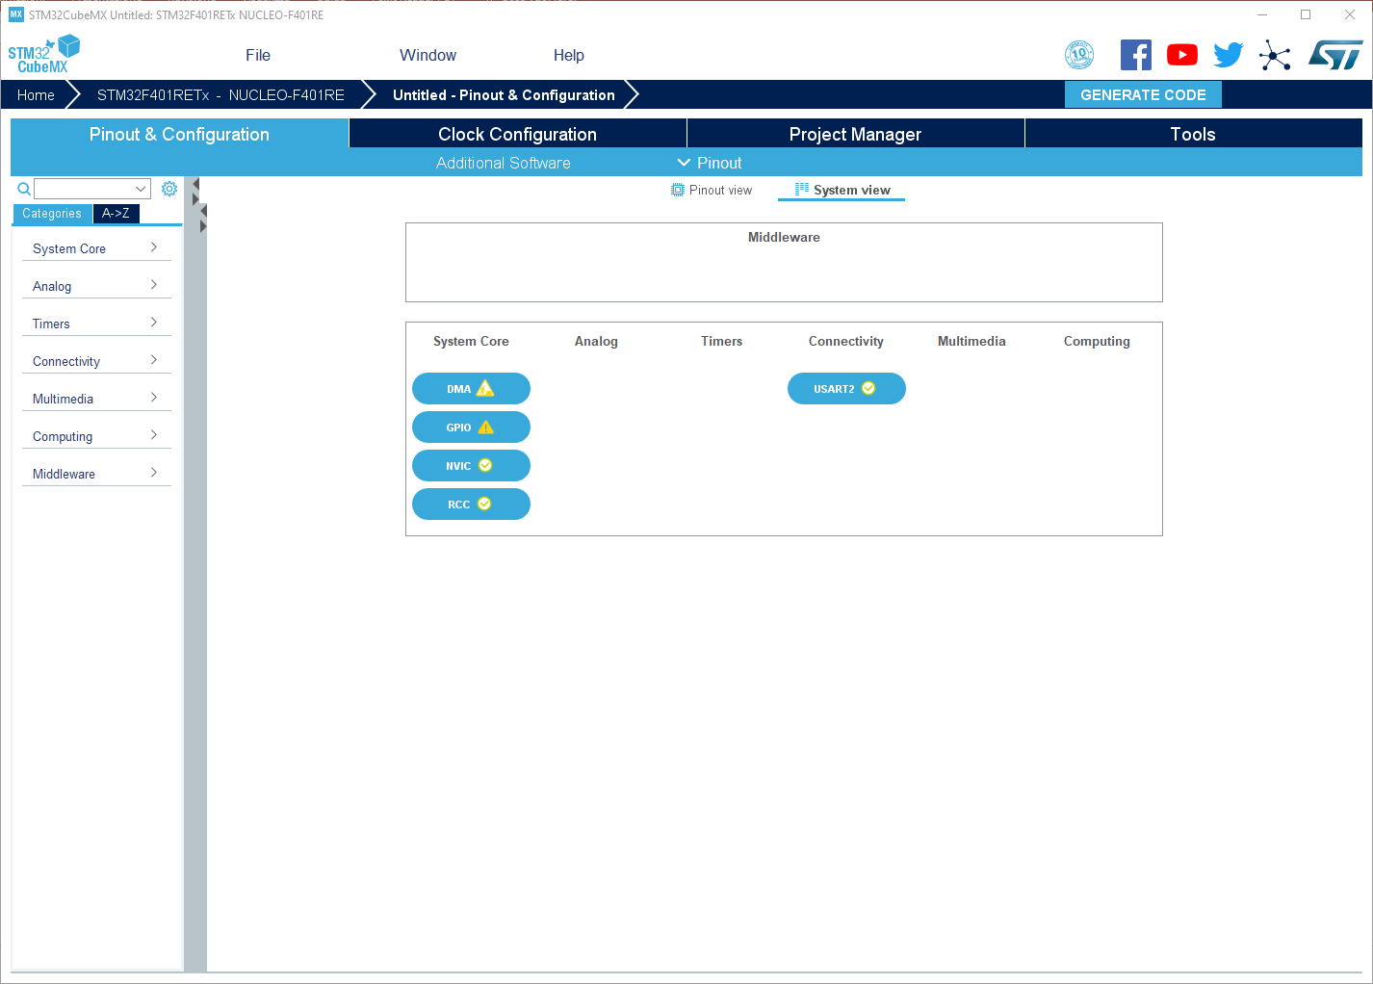
Stm32 cubemx – configuring the peripherals
System view tab allows us to configure all the peripheral. As you activate the peripheral from “Pinout” tab, those will be added here

Slide 8
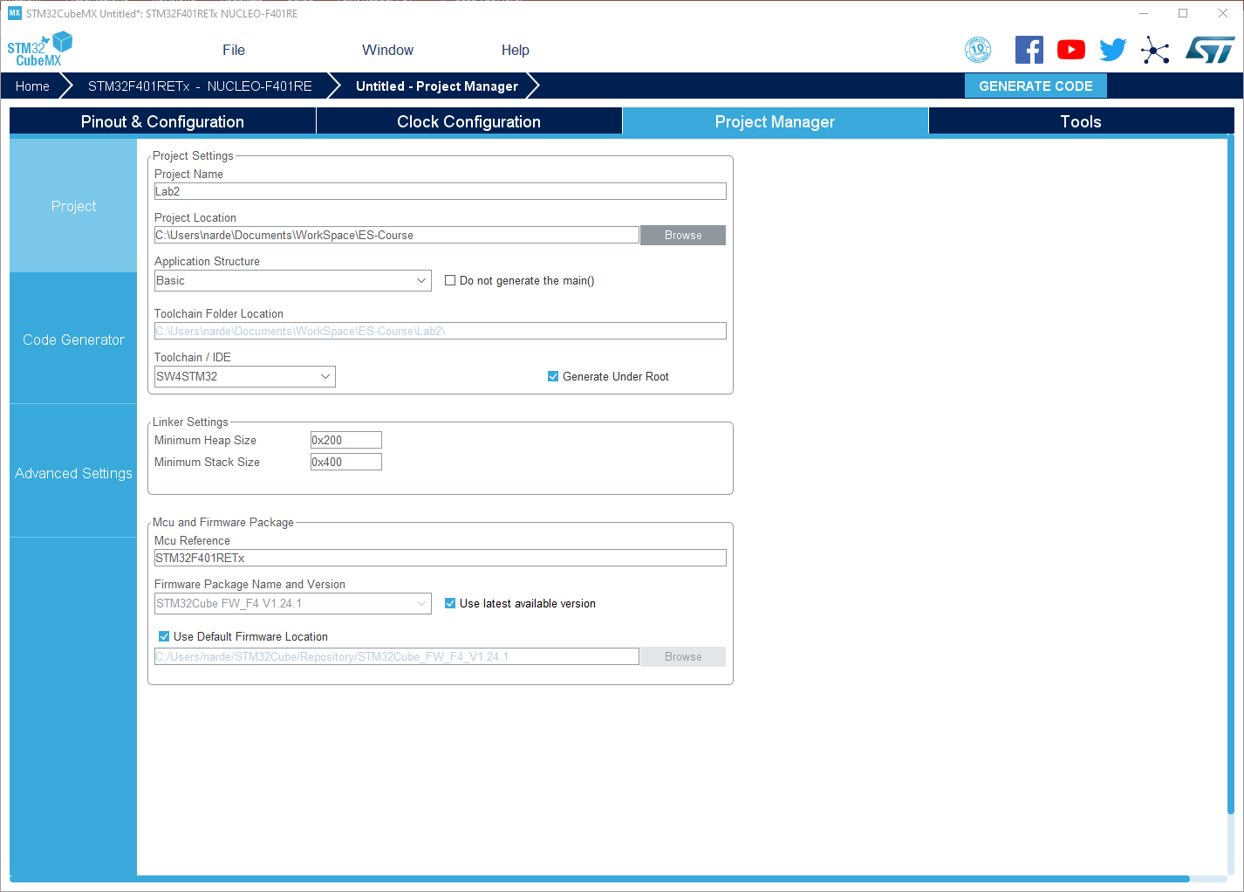
Stm32 cubemx – setting the toolchain
Change the toolchain / IDE to system workbench
Once everything is configure, we can generate the code

Slide 9
Systemworkbench
for stm32

Slide 10
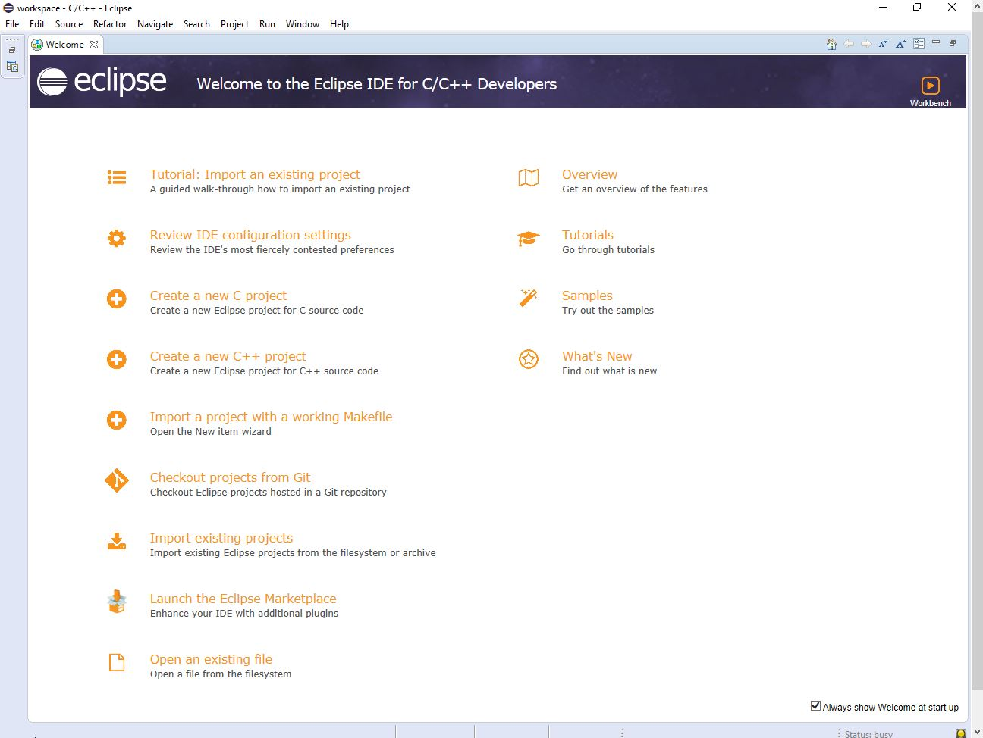
Stm32 – system workbench

Slide 11
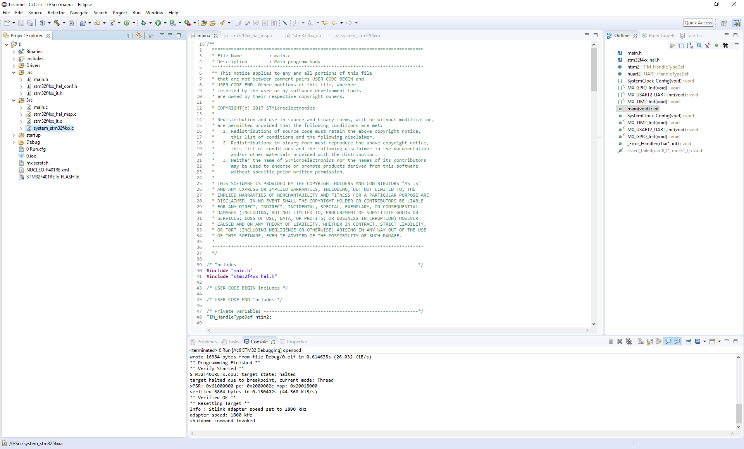
Stm32 – system workbench
main.c -> Main file
stm32f4xx_it.c -> Interrupt service routine
stm32f4xx_hal_msp.c -> HAL library initialization
system_stm32f4xx.c -> System low level config

Slide 12
Stm32 – system workbench
We can build the code pressing the hammer icon, while for executing it inside our development platform, press the green arrow

Slide 13
Additional material
MCU Datasheet
http://www.st.com/content/ccc/resource/technical/document/datasheet/30/91/86/2d/db/94/4a/d6/DM00102166.pdf/files/DM00102166.pdf/jcr:content/translations/en.DM00102166.pdf
STM32 Nucleo-64 User manual
http://www.st.com/content/ccc/resource/technical/document/user_manual/98/2e/fa/4b/e0/82/43/b7/DM00105823.pdf/files/DM00105823.pdf/jcr:content/translations/en.DM00105823.pdf

Slide 14
Exercise 1: toggle the led

Slide 15
Ex 1 – toggle the led
This demo is focused on GPIO, in particular 2 GPIO already wired to
the Green Led (LD2) through PIN 5,
the Blue Button (B1) through PIN 13.
GPIO (General Purpose Input Output) is the interface that allows microprocessor / memory to communicate through Input-Output channels. In our case, Input and Output are managed by two 2-state Pins (5 and 13)
We will se how to switch the led in 3 way:
Polling the Blue Button
By direct Read/Write on Pin using a delay
Capture an Interrupt generated by the Blue Button.

Slide 16
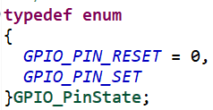
Stm32 gpio – set/reset
void HAL_GPIO_TogglePin( GPIO_TypeDef* GPIOx, uint16_t GPIO_Pin)
/**
* @brief Toggles the specified GPIO pins.
* @param GPIOx Where x can be (A..K)
* @param GPIO_Pin Specifies the pins to be toggled.
* @retval None
*/

Slide 17
Stm32 gpio – set/reset
void HAL_GPIO_WritePin(GPIO_TypeDef* GPIOx, uint16_t GPIO_Pin, GPIO_PinState PinState)
* @brief Sets or clears the selected data port bit.
* @note This function uses GPIOx_BSRR register to allow atomic read/modify accesses. In this way,
* there is no risk of an IRQ occurring between the read and the modify access.
* @param GPIOx where x can be (A..K)
* @param GPIO_Pin specifies the port bit to be written.
* This parameter can be one of GPIO_PIN_x where x can be (0..15).
* @param PinState specifies the value to be written to the selected bit.
* This parameter can be one of the GPIO_PinState enum values:
* @arg GPIO_PIN_RESET: to clear the port pin
* @arg GPIO_PIN_SET: to set the port pin
* @retval None

Slide 18
Stm32 gpio - read
GPIO_PinState HAL_GPIO_ReadPin (GPIO_TypeDef* GPIOx, uint16_t GPIO_Pin)
/**
* @brief Reads the specified input port pin.
* @param GPIOx where x can be (A..K) to select the GPIO peripheral for STM32F429X
* @param GPIO_Pin specifies the port bit to read. This parameter can be GPIO_PIN_x
where x can be (0..15).
* @retval The input port pin value.
*/

Slide 19
Stm32 gpio – toggle by interrupt
Checking the LED, you can notice that the behavior isn’t always as expected: most times it toggles correctly, but sometimes the LED looks like switching ON (or OFF), erroneously. This because we can miss Blue Button press event or we can double read it.
To solve this trouble, we introduce the Interrupt technique. The generates a signal alerting the system of the Pin 13 activation. When the Interrupts is received, the Led toggles.

Slide 20
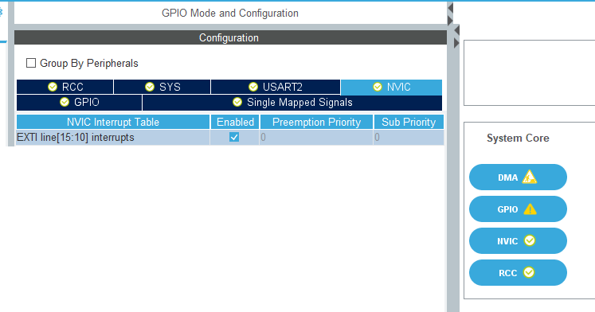
Stm32 gpio – toggle by interrupt
To enable the interrupt, go back to cubeMX and under
NVIC activate Interrupts EXTI Line [15:10].
Once done,
re-generate the code.

Slide 21
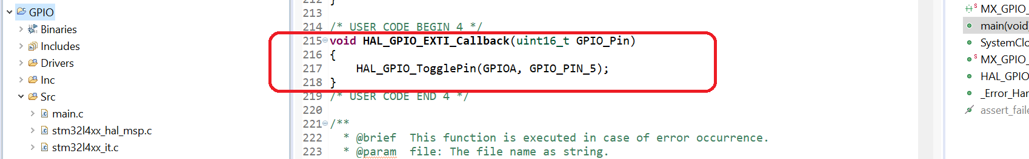
Stm32 gpio – toggle by interrupt
Once activated the interrupt, we have to add the callback that is called when the interrupt is fired. Inside this function, we toggle the LED status
You can see that the troubles of before are solved. There aren’t “false” reads and lags. Each Blue Button push generate 1 univocal Interrupt and a corresponding univocal Led toggle. (of course we can still have bouncing)

Slide 22
debug

Slide 23
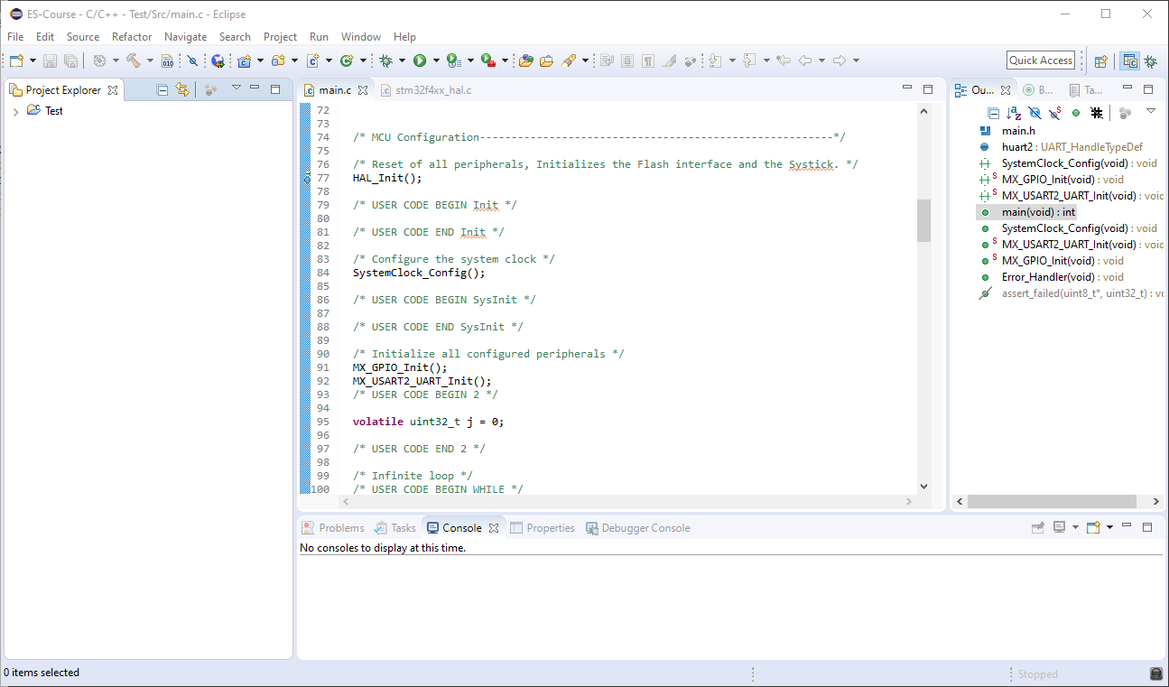
Stm32 debug
Sometimes we are interested in knowing what is happening inside our microcontroller.
We can start a debug session by pressing the bug icon
What is the value of J during run time?

Slide 24
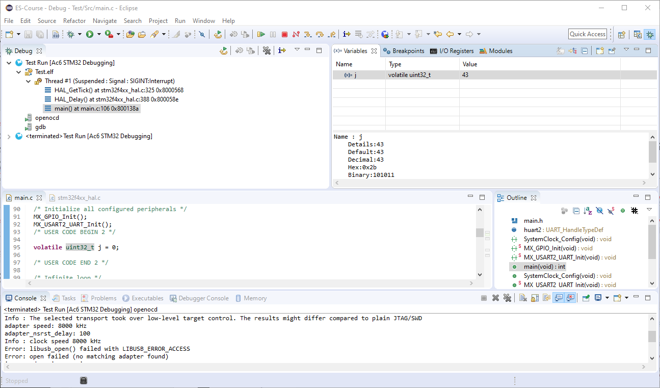
Stm32 debug
We can run the code step by step, or use breakpoints to stop the code at specific points
Interactive code execution control buttons

Slide 25
Stm32 debug
Debug functionality allow us to interactively run the code and to check register and variable actual values

Slide 26
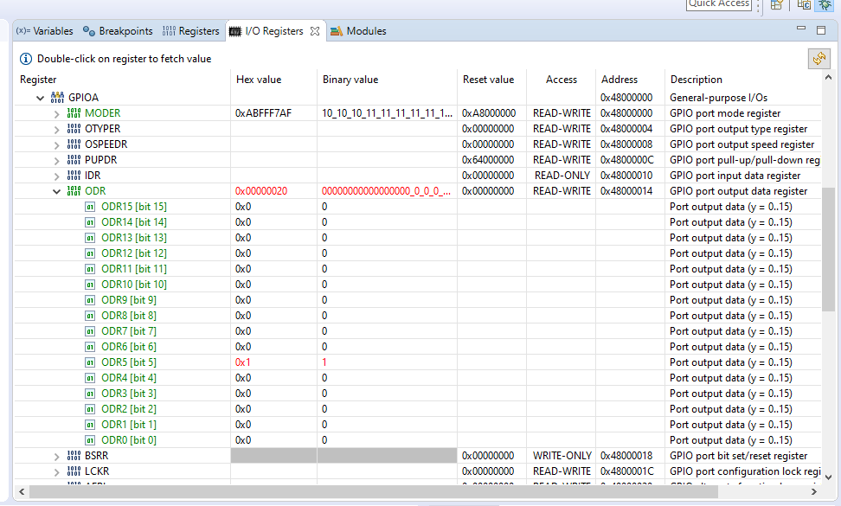
Stm32 debug
We can also inspect I/O registers to check specific configuration or input/output values.
When the LED is ON the associated register bit is set

